Slide 1
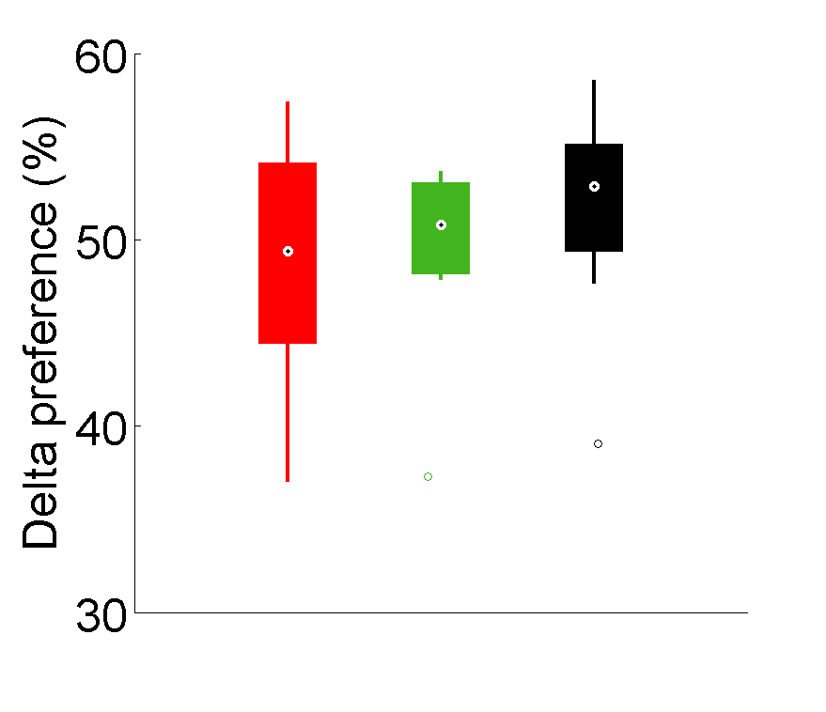
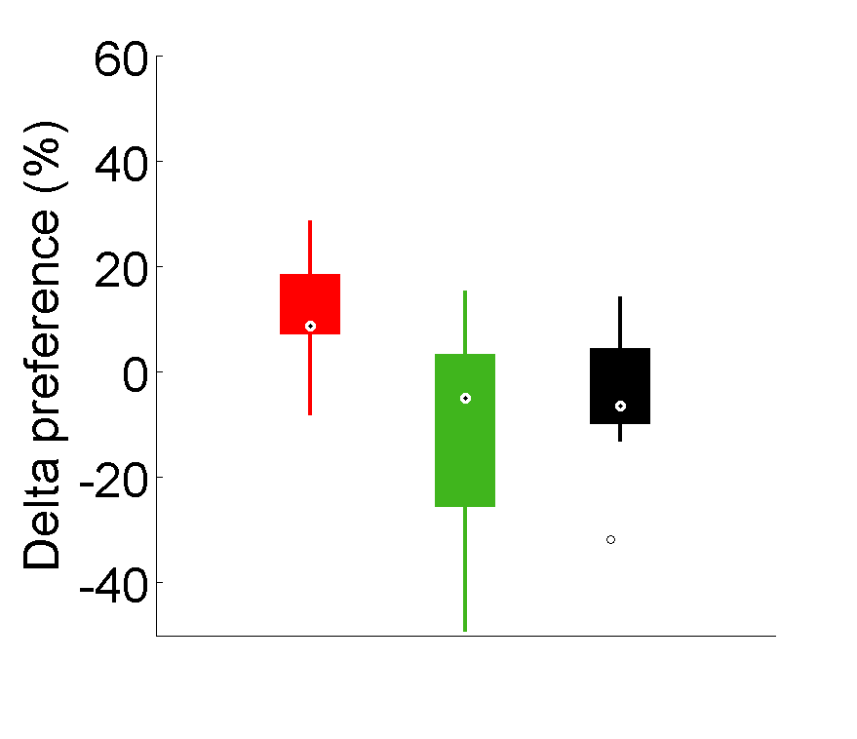
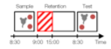
A
B
C
**
*
Sampling
Retention
Test
*
Delta Preference (%)
Preference (%)
Chance
level
Chance
level
8:30
9:00
15:00
8:30
Time
Sampling
24H Test
IN
OUT
NoSTIM

